Slide 1
Secure Data Hiding in Image Using Steganography
CAPSTONE PROJECT
Presented By:
Student Name : ANJALA TASNEEM S R
College Name & Department : SRMIST Ramapuram
B.Tech CSE ”Cyber Security”

Slide 2
OUTLINE
Problem Statement
Technology used
Wow factor
End users
Result
Conclusion
Git-hub Link
Future scope

Slide 3
Problem Statement
The project addresses the need for secure message transmission by allowing users to hide and retrieve encrypted messages within image files without altering the visual integrity of the image.

Slide 4
Technology used
Python – The main programming language.
Tkinter – For building the graphical user interface (GUI).
PIL (Pillow) – For image processing.
Cryptography (Fernet Encryption) – For securing hidden messages.
Google Translate API (translate library) – For text translation.
pyttsx3 – For text-to-speech (TTS).
Base64 Encoding – For password management.

Slide 5
Wow factors
Encryption – Adds an extra layer of security to the hidden message. Decryption with Password – Only users with the correct password can retrieve the message. Multi-Language Translation – Converts extracted text into different languages. Text-to-Speech (TTS) – Reads the hidden message aloud.

Slide 6
End users
Cybersecurity Enthusiasts – Secure communication. Journalists & Whistleblowers – Send hidden information securely. Students & Researchers – Learn about steganography and encryption. General Users – Hide private messages in images for fun or security.

Slide 7
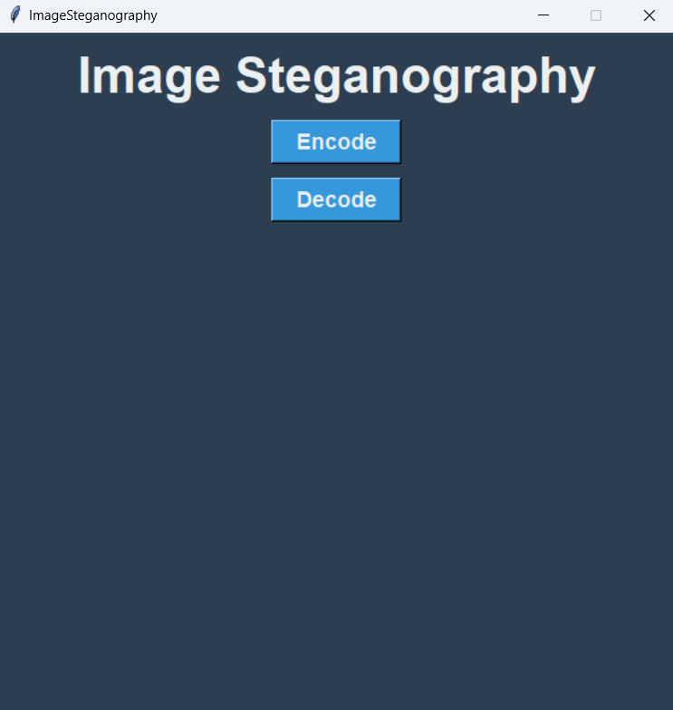
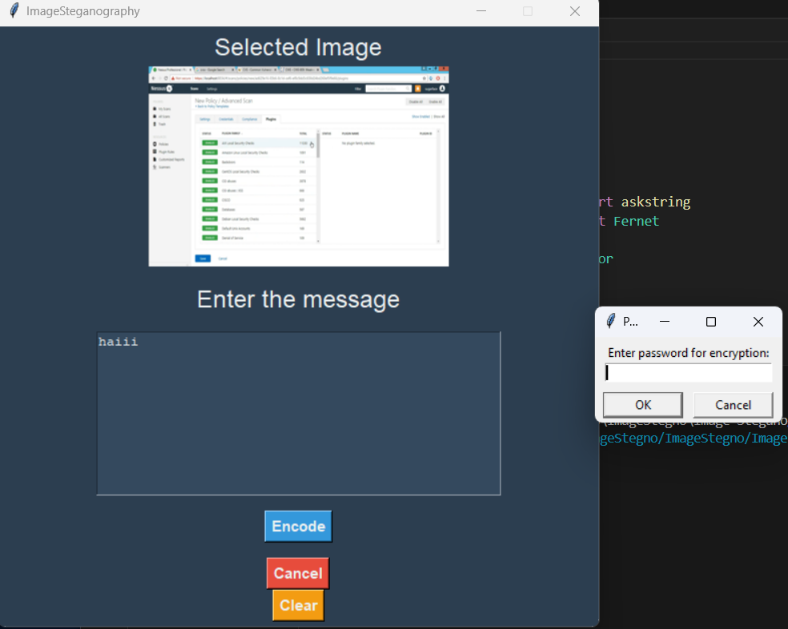
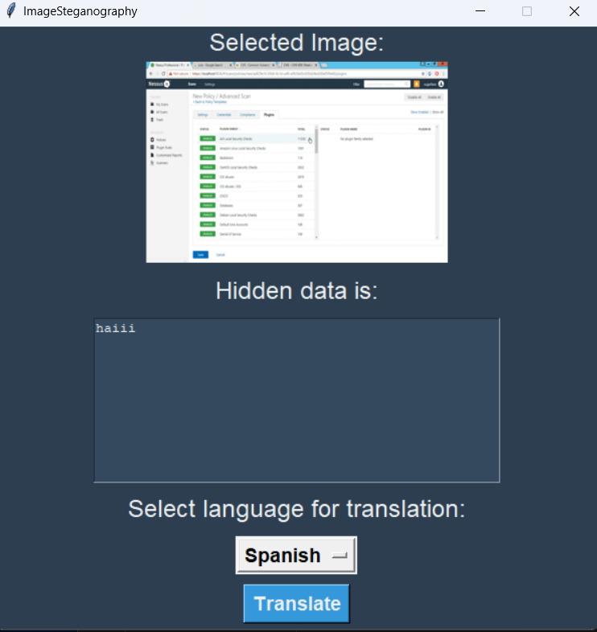
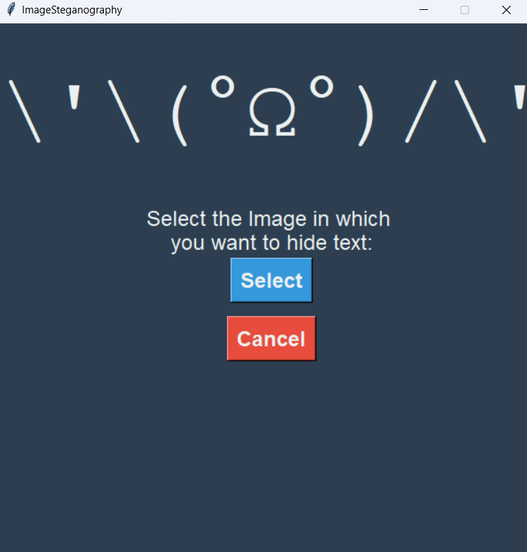
Results

Slide 8
Conclusion
This project implements Image Steganography with encryption, password protection, translation, and text-to-speech features, making it a secure and user-friendly tool for hiding and retrieving messages. With a simple Tkinter-based GUI, it is accessible to a wide range of users, from cybersecurity enthusiasts to general users needing private communication. The combination of steganography and encryption ensures data security, while additional features enhance usability, making this a practical and innovative solution.

Slide 9
GitHub Link
https://github.com/Anjala125/Image-Stegnography.git

Slide 10
Future scope(optional)
QR code-based message extraction for efficiency.
Blockchain integration for tamper-proof security.
Mobile app development for wider accessibility.
Enhanced image processing algorithms for better data capacity.

Slide 11
THANK YOU

